Slide 1
Unit 2 Data Types, Input and Output of Data Mining Algorithms

Slide 2
Introduction
Data types and characteristics of dataset has to be analysed
Data is classified as structured, unstructured and semi-structured data
Business databases mostly are structured
Scientific data may be of all three classes
Unstructured data may be like multimedia recordings
Structured data is also called traditional data
Other are non-traditional data
Most of the DM methods are applied to traditional data

Slide 3
Instances and Features
Potential measurement is called as Features
Features are measured uniformly over many cases
Representation of structured data is in tabular form or in the form of single relation
Each row is the instances or it is sample

Slide 4
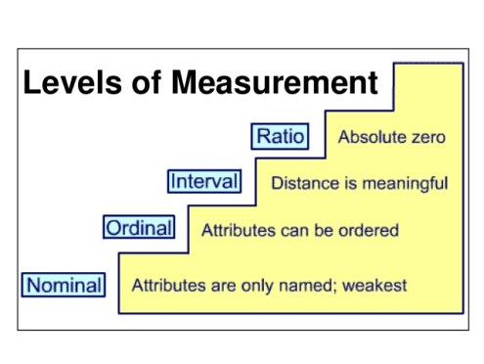
Types of Features
Nominal variables – Features which help to identify unique entities
Ordinal variables – categories that can be rationally listed in some order
Interval variables – ordinal variables in which the distance between the ordered categories can be measured
Ratio variables – interval variables which can have zero starting point

Slide 5
Data Mining algorithms,
Do not distinguish nominal and ordinal type
Do not distinguish ratio and interval variables
They are concerned whether the variables are unordered labels or ordered labels

Slide 6
Concept learning and Concept Description
4 types of DM methodologies
Classification learning
Association learning
Clustering
Regression

Slide 7
Classification learning
Here, you have set of classified examples from which you are expected to learn a way of classifying unseen examples
The required set of rules to partition the data into exclusive groups is called classification rules. The data used for deriving such rules is called training set.
The rules can then be used to discover as to which group a new customer belongs to.

Slide 8
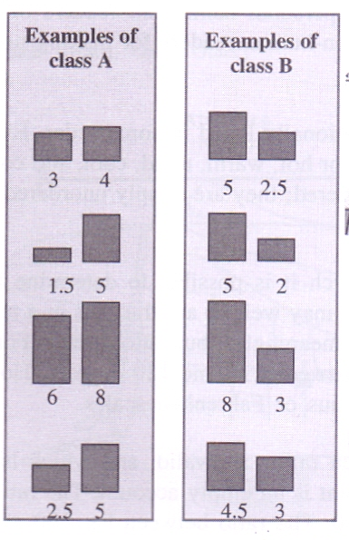
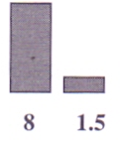
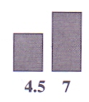

Slide 9
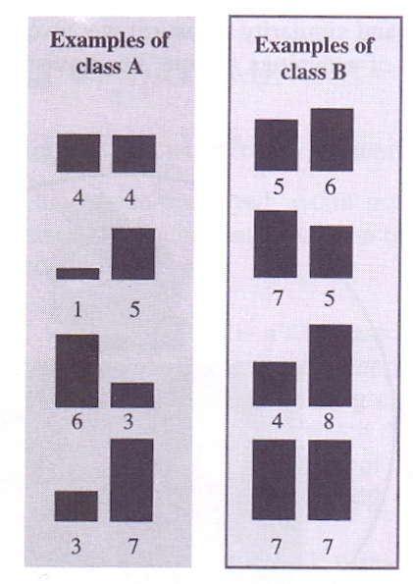
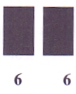

Slide 10
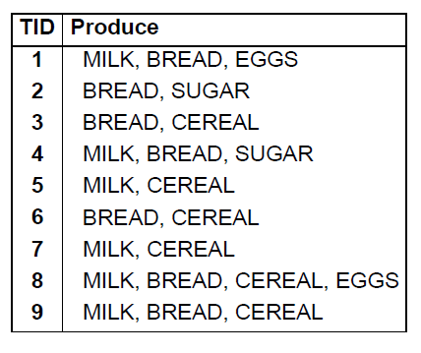
Association learning
Association between the features is derived.
The output will be association rules.

Slide 11
Clustering
Groups of examples that belong together are sought
Grouping is based on the similarity of features
Clustering can be applied to
Marketing : finding group of customers with similar behaviour
Biology: grouping of plants and animals based on their features
Libraries: book ordering
Insurance: identifying groups of policy holders, identifying frauds
Earthquakes: Identifying group of places which receives earthquakes
www: Document classification, clustering web log data

Slide 12
Subject | A | B
1 | 1.0 | 1.0
2 | 1.5 | 2.0
3 | 3.0 | 4.0
4 | 5.0 | 7.0
5 | 3.5 | 5.0
6 | 4.5 | 5.0
7 | 3.5 | 4.5

Slide 13
Regression
Regression helps to perform numeric prediction
Here the outcome to be predicted is not a discrete class but a numeric quantity
State | District | Year | Jan | Feb | Mar | Apr
Karnataka | Uttar Kannada | 2006 | 0.0 | 0.0 | 8.3 | 0.6
Karnataka | Uttar Kannada | 2007 | 0.0 | 0.1 | 1.9 | 27.8
Karnataka | Uttar Kannada | 2008 | 0.0 | 5.3 | 95.3 | 11.9
Karnataka | Uttar Kannada | 2009 | 0.0 | 0.0 | 27.6 | 16.4
Karnataka | Uttar Kannada | 2010 | 8.9 | 0.0 | 1.7 | 48.9

Slide 14
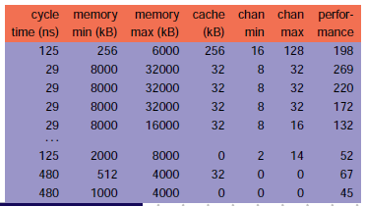

Slide 15
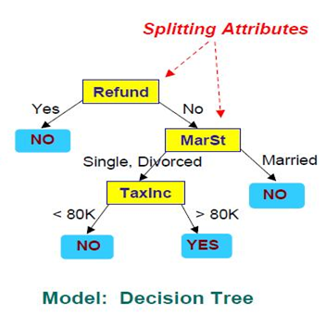
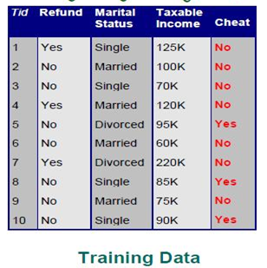
Output of Decision Trees

Slide 16
Output of Data Mining
Knowledge output from classified learners
Decision trees
Neural Networks
Decision tree is a tree based knowledge representation methodology used to represent classification rules.
The leaf node represents the class labels while other node represents the attributes associated with the objects being classified.
The branches of the tree represent each possible value of the attribute node from which they originate

Slide 17
Output of Association Rules
{Cereal, Milk} → Bread [sup=22%, conf=50%]
Association rule:
22% chance that customers buy all the three products together
50% chance that customers who buy cereal and milk will buy bread

Slide 18
Clustering
Subject | A | B
1 | 1.0 | 1.0
2 | 1.5 | 2.0
3 | 3.0 | 4.0
4 | 5.0 | 7.0
5 | 3.5 | 5.0
6 | 4.5 | 5.0
7 | 3.5 | 4.5
Cluster1: 1,2
Cluster2: 3,4,5,6,7

Slide 19
The cluster output can be visualised as
Table form
Venn diagram
Dendrograms
Self-organizing maps

Slide 20
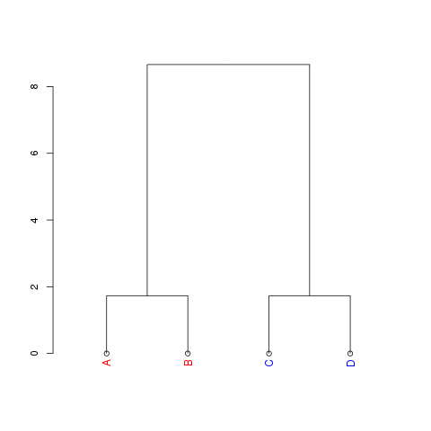
1
7
3
6
2
4
5

Slide 21
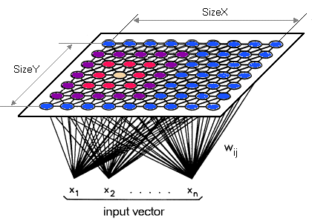

Slide 22
Regression
Generally trees for numeric prediction
Regression tree – leaf predicts a numeric qty. Predicted value is the average value of training instances that reach the leaf
Model tree – linear regression models at the leaf nodes.

Slide 23
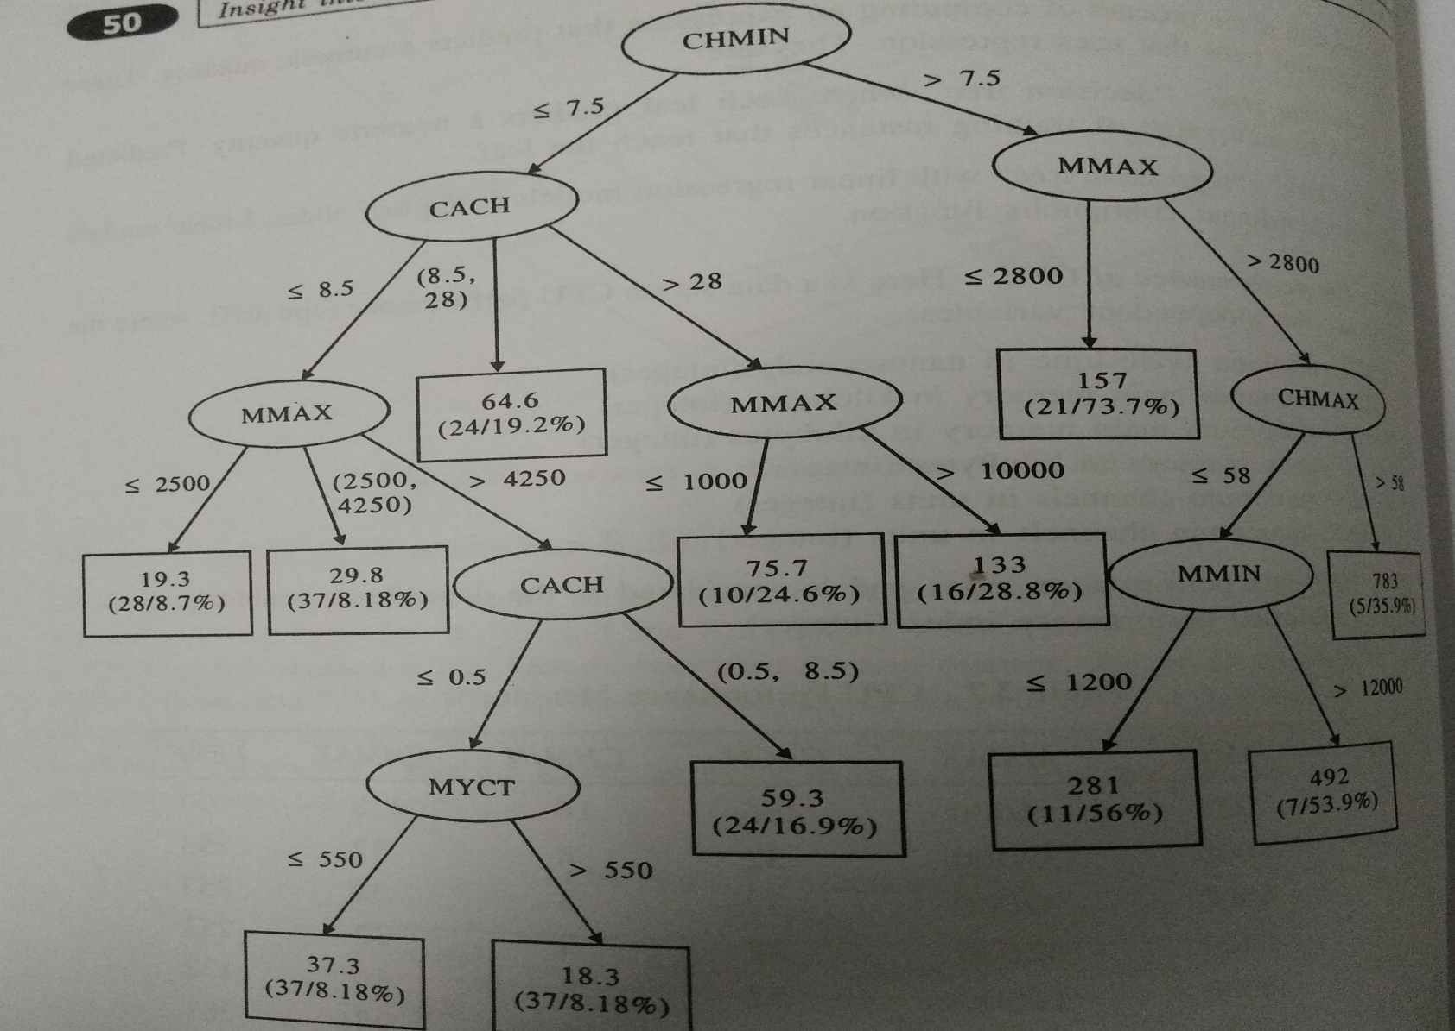
Regression tree

Slide 24
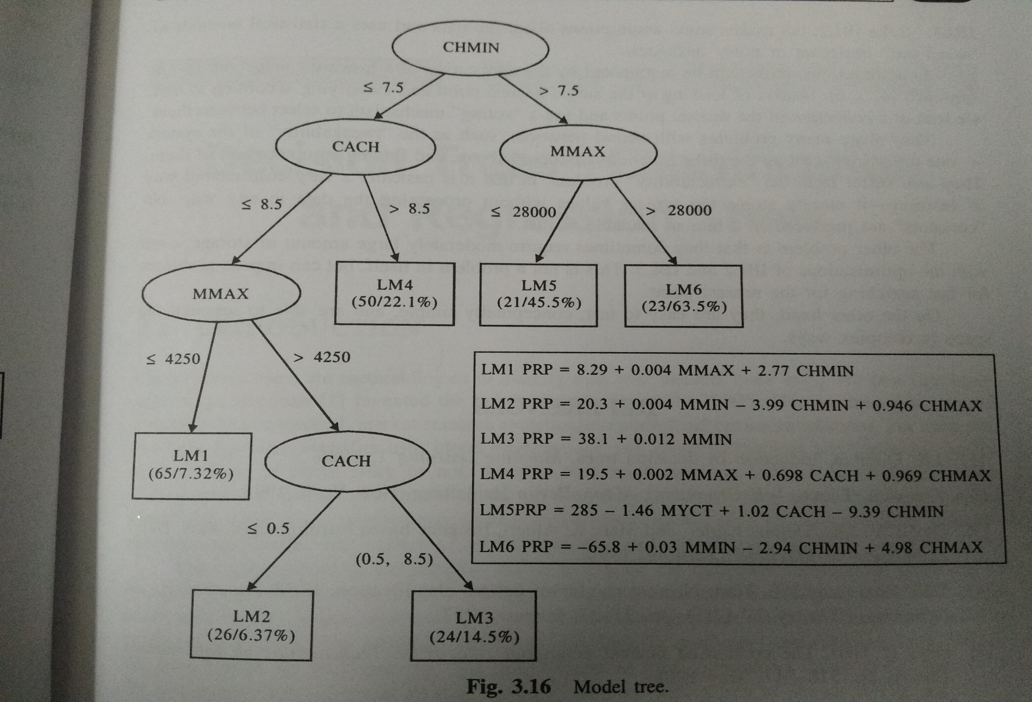
Model tree

Slide 25
Unit 2– Part II Preprocessing and Postprocessing

Slide 26
Introduction
Essential - Preparation and transformation of the initial dataset.
If data comes from data warehouse, some transformation might be already done.
It may not be the fullest extent.
Some transformations may be done during data mining process only.
Many transformations may be needed to produce features more useful for selected data mining methods like prediction or classification

Slide 27
Steps in Preprocessing
Choosing the object representation
Choose the appropriate attributes
Distinguish the attributes as categorical or numerical
Whether Structured ?
Mapping and collecting data
Represent the data uniformly Like date 08/02/2018 08-02-2018
Scaling large datasets
See that the complete dataset could be placed in memory
If not use windowing/batch incremental mode

Slide 28
Steps in Preprocessing
Handling noise and errors
Handle External errors and internal errors separately
Processing unknown attribute values
Unknown values / missing values
Caused due to data lost, NA, doesnot exist, irrelevant to context
Discretization/Fuzzification of numerical attributes
Discretize the numerical value
Extension of discretization is fuzzification
Offline or online processing can be done

Slide 29
Normalization/Fuzzification
V={8,10,12,20} actual min = 8 actual max=20
New min = 0
New max=1
V’ = (V-min) X (newmax-newmin) + newmin
max-min
V’[8] = 8-8/12 * 1 = 0/12=0
V’[10] = 10-8/12*1=2/12=0.16

Slide 30
Steps in Preprocessing
Processing of continuous classes
We may have discretized symbolic classes or continuous numeric classes
Grouping of values of symbolic attributes
Grouping of symbolic values if classes are more
It helps in making decision/classification rules easier
Attribute selection and ordering
Select attributes and order according to the target concept
Attribute construction and transformation
Reform and Transform the attribute if required such that the learning becomes easy
Consistency checking
Check for the consistency of the data. First do it offline and then online

Slide 31
Discretization
The process of partitioning the continuous variables into categories is usually termed as discretization.
Interval labels can then be used to replace actual data values
Discretization can be done recursively on a attribute
Discretization helps in reduce the data size
It helps in transforming the quantitative data into qualitative data
Unsupervised – Binning - equal width methods or equal frequency methods
Supervised – entropy or information gain which measure strength of relationship to determine which group it belongs to
Supervised – may lead to accurate calculation

Slide 32
Manual approach
Manually define the cut points for the data.
They are defined subjectively
Unsupervised method – Binning
Binning does not use class information for discretization
Equi width binning
Equi frequency binning
Supervised method – Entropy Selection

Slide 33
Equi Width binning
The algorithm divides the data into k intervals of equal size
The width of interval is
W = (max-min)/k
The interval boundaries are
min+w,min+2w,…..min+(k-1)w

Slide 34
Equi frequency Binning
The algorithm divides the data into k groups where each group contains approximately equal number of values
For both methods, the best way of determining the k value is by seeing the histogram and trying different intervals or groups

Slide 35
Entropy based discretization
The goal of this algorithm is to find the split with the maximum information gain
The boundary that minimizes the entropy over all possible boundaries is selected
The process is recursively applied to partitions obtained until some stopping criterion is met
Such a boundary may reduce data size and improve classification accuracy

Slide 36


Calculating Entropy
For m classes
For 2 classes
Calculated based on the class distribution of the samples in set S.
pi is the probability of class i in S
m is the number of classes (class values)

Slide 37
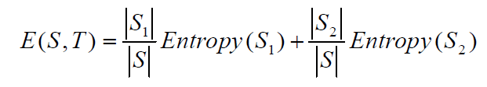
Calculating entropy from Split
Entropy of subsets S and S2 Entropy of subsets S1 and S2 are calculated .
The calculations are weighted by their probability of being in set S and summed.
In formula below,
– S is the set
– T is the value used to split S into S1 and S2

Slide 38
Calculation of information gain
Information Gain = Difference in entropy between original set (S) and weighted split (S1 + S2)
Gain(S,T) = Entropy(S) − E(S,T)
It is always desired to have maximum information gain for effective split.
To find effective split take two split values and calculate information gain. Choose the split which has maximum information gain or less E(s1,s2)

Slide 39
Calculate Entropy for your data.
For each potential split in your data...
Calculate Entropy in each potential bin
Find the net entropy for your split
Calculate entropy gain
Select the split with the highest entropy gain
Recursively (or iteratively in some cases) perform the partition on each split until a termination criteria is met
Terminate once you reach a specified number of bins
Terminate once entropy gain falls below a certain threshold.

Slide 40
Practice
Hours Studied | A Grade on Test
4 | N
5 | Y
8 | N
12 | Y
15 | Y
 | A on Test | Lower than A
Overall | 3 | 2

Slide 41
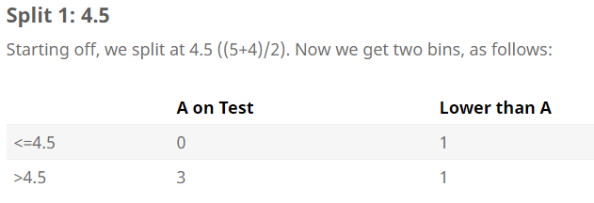
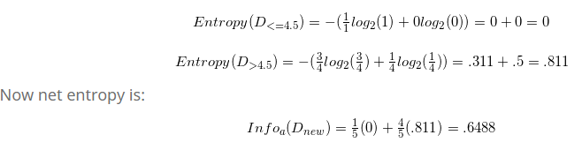

Slide 42
Practice Problem on Binning
Given are the recorded temperature in a day
10,18,22,25,24,21,20,20,19,18,15.
Discretize using equi width binning and equi frequency binning with k=4

Slide 43
Practice Problem on Entropy
For the given data set calculate the entropy on the target variable
For the given data set calculate the entropy of the predictor variable with a possible split of x<=17 and x>17
Calculate the information gain on (21,S).
Predictor variable x | Target variable y
4 | M
12 | M
16 | M
18 | F
24 | F
26 | F

Slide 44
Practice Problem on Quantile
Find the quantile and IQR for the following dataset without applying correction factor for the recorded temperature in a day.
10,18,22,25,24,21,20,20,19,18,15

Slide 45
Feature Extraction, Selection and Construction
Dimensionality reduction
Goal: represent instances with fewer variables
Try to preserve as much as structure in the data as possible
Feature Extraction
Construct new set of dimensions ei=f(x1…xd)
(linear)combinations of original
Can be done using Feature mapping algorithms
Feed forward networks – (Feature Extraction)
Principal component analysis ( Dimensionality reduction)

Slide 46
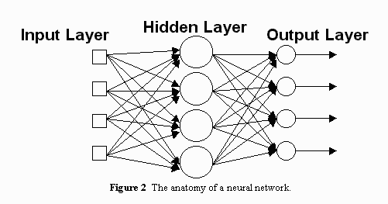
Feed forward networks – preserve the features of the first hidden layer in neural network

Slide 47
Principal component analysis is a method of extracting important variables (in form of components) from a large set of variables available in a data set.
It extracts low dimensional set of features from a high dimensional data set with a motive to capture as much information as possible.
With fewer variables, visualization also becomes much more meaningful. PCA is more useful when dealing with 3 or higher dimensional data.

Slide 48
It is always performed on a symmetric correlation or covariance matrix. This means the matrix should be numeric and have standardized data.
Feature Extraction by PCA
Covariance matrix |  |  |  | Eigen Values | Proportion
1 | -0.1094 | 0.8718 | 0.818 | 2.9108 | 0.7277
-0.1094 | 1 | -0.4205 | -0.3565 | 0.9212 | 0.2303
0.8718 | -0.4205 | 1 | 0.9628 | 0.1474 | 0.0368
0.818 | -0.3565 | 0.9628 | 1 | 0.0206 | 0.0052

Slide 49
Missing data
Missing data are the data we desired to collect but never got into our database for subsequent analysis
Reasons for missing data
Respondents refusal to answer an item
Respondents does not know the answer
Data not applicable
Consequence : inaccurate conclusion

Slide 50
Three classes of missing data
Missing completely at random (MCAR) – the probability of missing data on Y is not dependent on Y or X
Missing at random (MAR) – the probability of missing data on Y depends on the value of X
Not missing at random(NMAR) – probability of missing data on Y is dependent on value of Y

Slide 51
Handling missing values
Eliminate data objects
Estimate missing values
Missing data substitution (mean, median, specific value, regression substitution)
K-nearest neighbours
Ignore the missing values during analysis
Replace with all possible values(weighted by their probabilities)

Slide 52
Post Processing
Knowledge filtering
Interpretation and explanation
Evaluation
Knowledge integration

